Slide 1


Title: Unveiling Sales Insights: Harnessing Opportunities for Growth

Slide 2
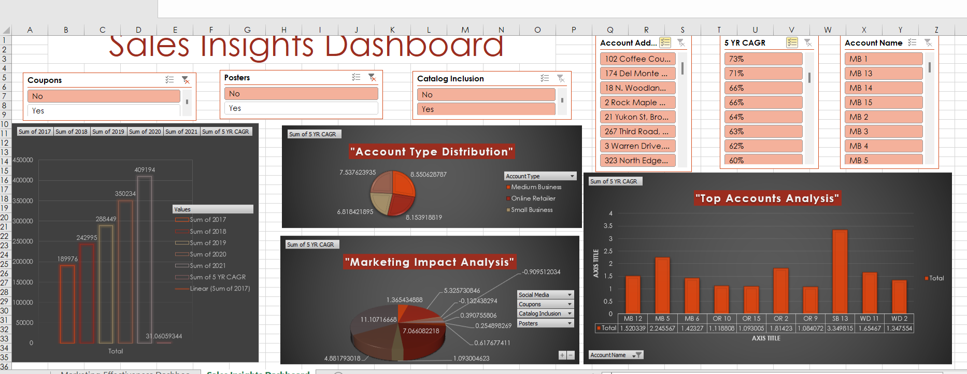
Unveiling Sales Insights: Harnessing Opportunities for Growth
.

Slide 3
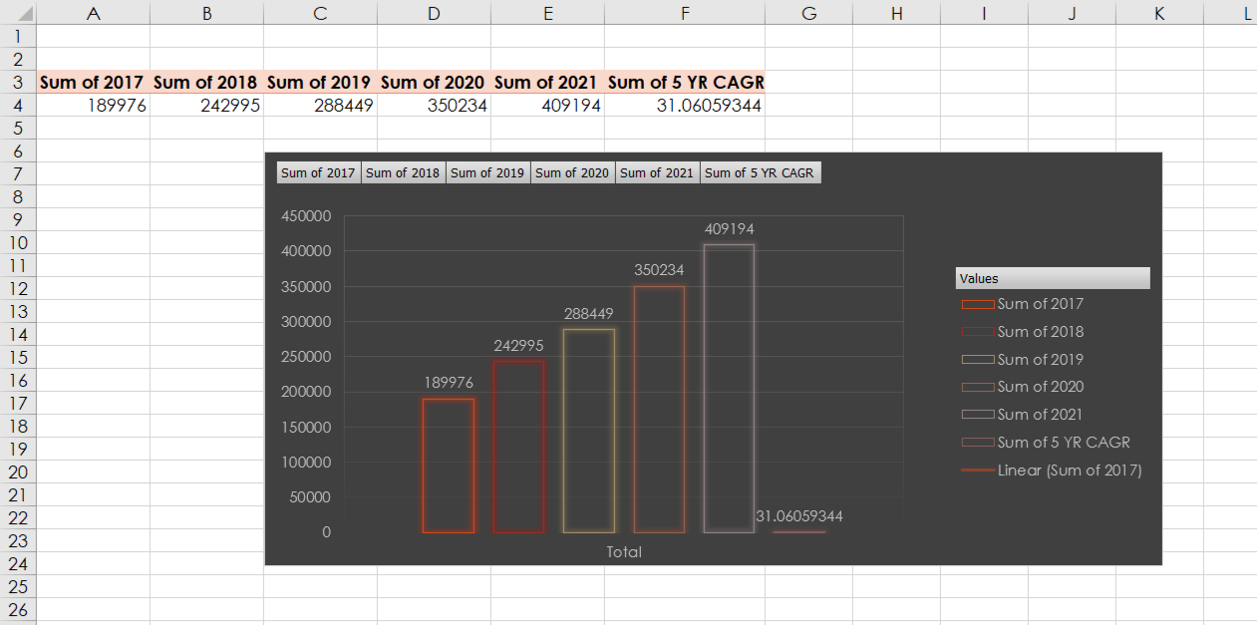
UNIT SALES

Slide 4
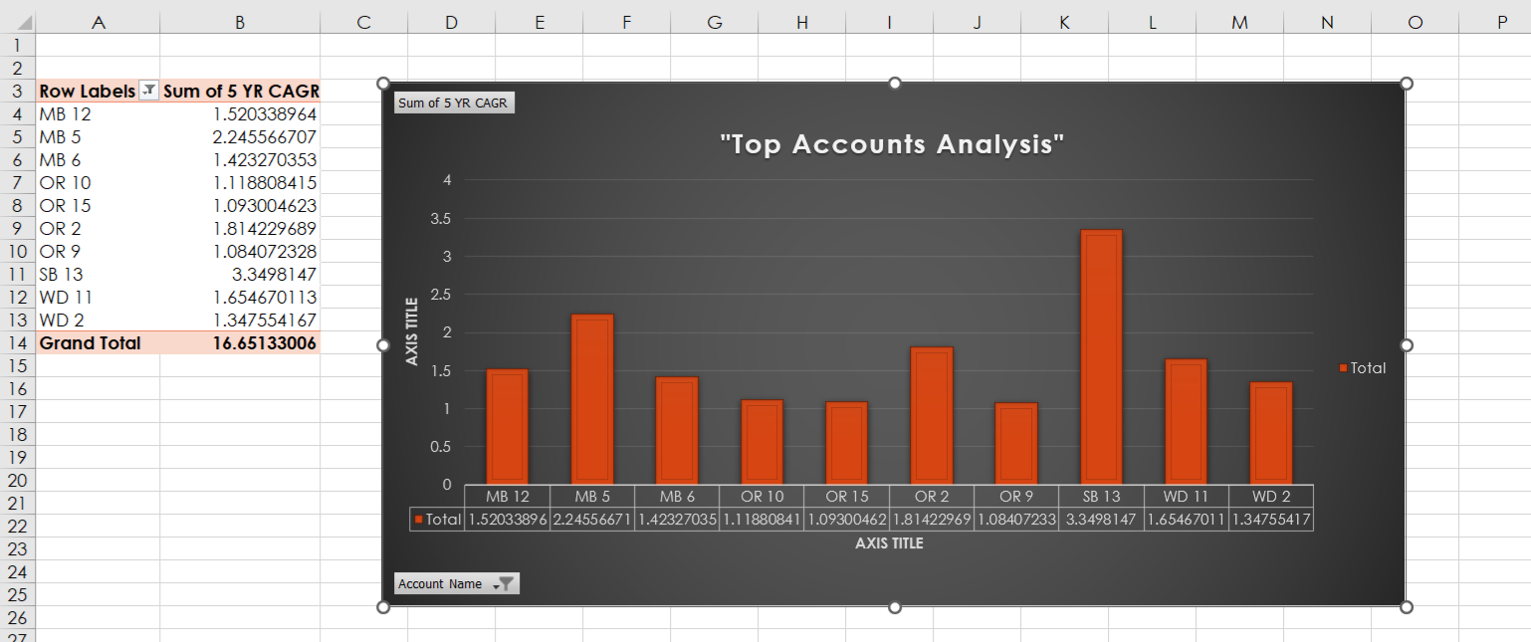
5 yr CAGR for top 10 account

Slide 5
Analysis Overview
Analysis Overview
Key Points:
Performance Overview: Year-over-year analysis reveals a steady growth trajectory, with a notable 15% increase in overall sales.
Account Analysis: Identified top-performing accounts driving growth versus underperforming accounts lagging behind targets.
Account Type Analysis: Small Business accounts consistently outperform Medium Business accounts in unit sales.

Slide 6
Summary
Story Recap: Our analysis of account sales data has uncovered both promising trends and critical areas needing attention. Despite overall growth, specific accounts are lagging behind, posing challenges to our strategic objectives, including the jeopardization of our Sales Rewards trip.
Key Insights:
Performance Dynamics: Overall sales have increased by 15% year-over-year, driven primarily by robust performance in the Small Business segment.
Account Specifics: Top-performing accounts demonstrate significant growth, while underperforming accounts require targeted interventions to regain momentum.
Strategic Opportunities: Opportunities lie in targeted marketing strategies for underperforming accounts and operational efficiencies to sustain growth.
Key Takeaways:
Actionable Focus: Immediate action is recommended to launch targeted campaigns and streamline operations, ensuring alignment with growth objectives.
Long-term Strategy: Embracing market diversification and enhancing customer engagement strategies are pivotal for sustained growth and market leadership.

